Slide 1

Analysis of hotel bookings based on hotel reviews
DONE BY: SIMRAN KAUR GAHIR

Slide 2
Table of content
Introduction
Review of datasets
Findings from the dataset
Visualizations
Future goals
conclusion
Business recommendations

Slide 3

Introduction
A warm welcome everyone here today to analysis how hotel bookings are made according to the reviews of the hotel.
Today we will analysis and compare how hotel bookings and hotel reviews go hand in hand.

Slide 4
Overview of the dataset
We used two datasets, one containing information about hotel bookings for the whole year. The second dataset contains information about reviews of hotels.
Both datasets we cleaned thoroughly and were merged to become one for analysis of data.

Slide 5
Key findings
The arrivals per month
Our analysis showed that there were more people who booked hotels in March to October than compared to the months of January, November and December.
In August there were the highest number of arrivals.
In January there were the lowest number of arrivals.

Slide 6
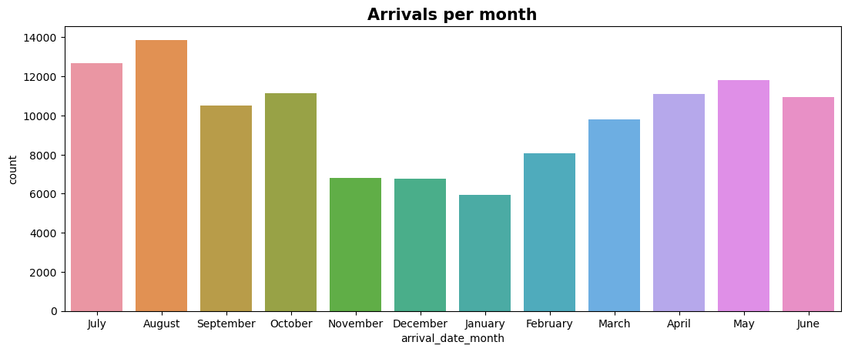

Slide 7
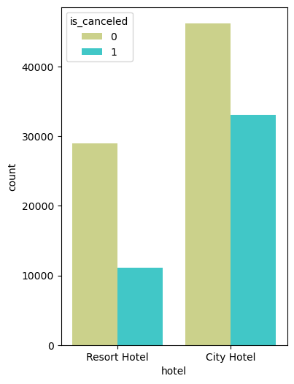
2) Number of bookings that were cancelled in the city hotel and resort hotel.
City hotel had more cancellations hence had low reviews.
Resort hotels had a low cancellation rate hence had high reviews.

Slide 8
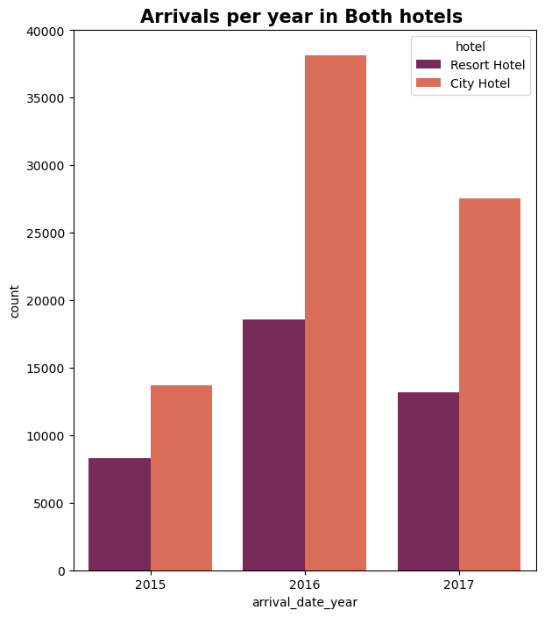
3) Arrival of visitors per year in both hotels
According to our analysis 2016 had the highest arrival rate in the city hotel and the resort hotel followed by 2017 and lastly 2015.

Slide 9
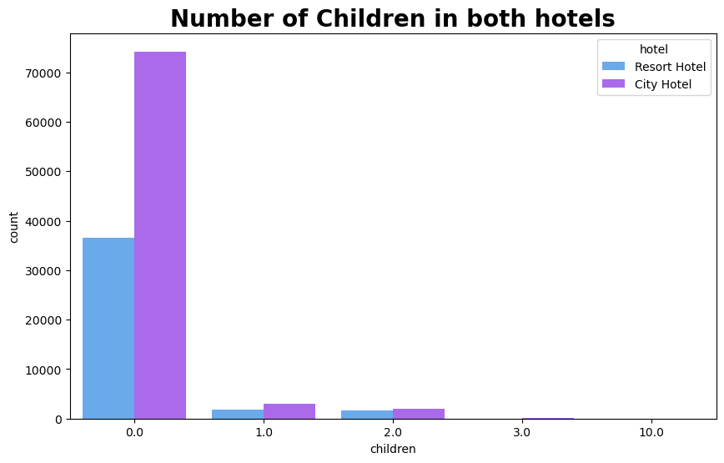
4) Number of children in both hotels
According to our findings there were more children in the city hotel as compared to in the resort hotel. Hence reviews for city hotel with children are higher.

Slide 10
Business recommendation
1)Develop the hotel website online. This will create publicity for people who would like to come and stay there. Update the website with the latest pictures of the rooms and the facilities offered by the hotel eg swimming pool and recreational centers, gyms, spas and many more. Have connections with digital marketers to regularly update the hotel website.
2) Ensure the service in the hotel is good, this boosts the reviews that are posted online. If the hotel has a high number of reviews, then there will be a more visitors coming to stay there.

Slide 11
Future goals
Use technology to improve the guest's experience. Instead of have a key system for entering your room we can change it to a card system. This way it becomes more efficient while carrying the card around everywhere compared to the key.
Provide more activities to do in the hotels. For children we can open a children's club whereby all the children can play with soft toys and the supervisions can conduct friendly games to keep the children entertained. For adults there can be a morning water aerobics class. This will be fun and exciting for them as well as keeps them on their toes with exercising. The more the activities the more the visitors will enjoy their stay.

Slide 12
Conclusion
In conclusion we can see that most people prefer to travel during the summer holidays as compared to the start or end of the year. We have also seen that the reviews of the hotel affect the hotel booking as they go hand in hand. And as seen that most people tend to prefer the city hotel as it tends to have a lot of accessibility to the city shops as compared to the resort hotels.

Slide 13

Thank you all for taking a few minutes out of your busy schedule. If you have any further questions, please feel free to reach out to me.

